Slide 1
CYBER SECURITY
TRAINING
Footprinting |Social Engineering | Access Control and Identity Mgt | Ethical Hacking | Cybersecurity Career

Slide 2
MODULE 1
INTRODUCTION TO ETHICAL HACKING

Slide 3
INFORMATION SECURITY & THREAT
Information security refers to the processes and methodologies which are designed and implemented to protect print, electronic, or any other form of confidential, private and sensitive information or data from unauthorized access, use, misuse, disclosure, destruction, modification, or disruption.
Threat: can be anything that can take advantage of a vulnerability to breach security and negatively alter, erase, harm object or objects of interest.

Slide 4
INFORMATION SECURITY & THREAT
Insider Threat
An insider threat occurs when individuals close to an organization who have authorized access to its network intentionally or unintentionally misuse that access to negatively affect the organization's critical data or systems.
Viruses and worms
Viruses and worms are malicious software programs (malware) aimed at destroying an organization's systems, data and network. A computer virus is a malicious code that replicates by copying itself to another program, system or host file. It remains dormant until someone knowingly or inadvertently activates it, spreading the infection without the knowledge or permission of a user or system administration.

Slide 5
INFORMATION SECURITY & THREAT
Worm
A computer worm is a self-replicating program that doesn't have to copy itself to a host program or require human interaction to spread. Its main function is to infect other computers while remaining active on the infected system.
Botnet
A botnet is a collection of Internet-connected devices, including PCs, mobile devices, servers and IoT devices that are infected and remotely controlled by a common type of malware. Typically, the botnet malware searches for vulnerable devices across the internet. The goal of the threat actor creating a botnet is to infect as many connected devices as possible, using the computing power and resources of those devices for automated tasks that generally remain hidden to the users of the devices.

Slide 6
INFORMATION SECURITY & THREAT
Phishing attacks
Phishing attacks are a type of information security threat that employs social engineering to trick users into breaking normal security practices and giving up confidential information, including names, addresses, login credentials, Social Security numbers, credit card information and other financial information. In most cases, hackers send out fake emails that look as if they're coming from legitimate sources, such as financial institutions, eBay, PayPal -- and even friends and colleagues.
In phishing attacks, hackers attempt to get users to take some recommended action, such as clicking on links in emails that take them to fraudulent websites that ask for personal information or install malware on their devices.

Slide 7
INFORMATION SECURITY & THREAT
Distributed denial-of-service (DDoS) attacks
In a distributed denial-of-service (DDoS) attack, multiple compromised machines attack a target, such as a server, website or other network resource, making the target totally inoperable. The flood of connection requests, incoming messages or malformed packets forces the target system to slow down or to crash and shut down, denying service to legitimate users or systems.
Rootkits – are designed to gain root access or we can say administrative privileges in the user system. Once gained the root access, the exploiter can do anything from stealing private files to private data.

Slide 8
INFORMATION SECURITY & THREAT
Exploit kits
An exploit kit is a programming tool that enables a person without any experience writing software code to create, customize and distribute malware. Exploit kits are known by a variety of names, including infection kit, crimeware kit, DIY attack kit and malware toolkit. Cybercriminals use these toolkits to attack system vulnerabilities to distribute malware or engage in other malicious activities, such as stealing corporate data, launching denial of service attacks or building botnets.

Slide 9
INFORMATION SECURITY & THREAT
Social Engineering – is the art of manipulating people so that they give up their confidential information like bank account details, password etc. These criminals can trick you into giving your private and confidential information or they will gain your trust to get access to your computer to install a malicious software- that will give them control of your computer.
Outdated Security Software – With new threats emerging everyday, updating security software is a pre requisite to have a fully secured environment.

Slide 10
INTRODUCTION TO THE CYBER KILL CHAIN
What is Cyber Kill Chain
The cyber kill chain is a series of steps that trace stages of a cyberattack from the early reconnaissance stages to the exfiltration of data. The kill chain helps us understand and combat ransomware, security breaches, and advanced persistent attacks (APTs).
Lockheed Martin derived the kill chain framework from a military model – originally established to identify, prepare to attack, engage, and destroy the target. Since its inception, the kill chain has evolved to better anticipate and recognize insider threats, social engineering, advanced ransomware and innovative attacks.

Slide 11
INTRODUCTION TO THE CYBER KILL CHAIN
How the Cyber Kill Chain works
There are several core stages in the cyber kill chain. They range from reconnaissance (often the first stage in a malware attack) to lateral movement (moving laterally throughout the network to get access to more data) to data exfiltration (getting the data out). All of your common attack vectors – whether phishing or brute force or the latest strain of malware – trigger activity on the cyber kill chain.
Each stage is related to a certain type of activity in a cyber attack, regardless of whether it’s an internal or external attack:

Slide 12
INTRODUCTION TO THE CYBER KILL CHAIN
Reconnaissance
The observation stage: attackers typically assess the situation from the outside-in, in order to identify both targets and tactics for the attack.
Intrusion
Based on what the attackers discovered in the reconnaissance phase, they’re able to get into your systems: often leveraging malware or security vulnerabilities.
Exploitation
The act of exploiting vulnerabilities, and delivering malicious code onto the system, in order to get a better foothold.

Slide 13
INTRODUCTION TO THE CYBER KILL CHAIN
Privilege Escalation
Attackers often need more privileges on a system to get access to more data and permissions: for this, they need to escalate their privileges often to an Admin.
Lateral Movement
Once they’re in the system, attackers can move laterally to other systems and accounts in order to gain more leverage: whether that’s higher permissions, more data, or greater access to systems.
Obfuscation / Anti-forensics
In order to successfully pull off a cyberattack, attackers need to cover their tracks, and in this stage they often lay false trails, compromise data, and clear logs to confuse and/or slow down any forensics team.

Slide 14
INTRODUCTION TO THE CYBER KILL CHAIN
Denial of Service
Disruption of normal access for users and systems, in order to stop the attack from being monitored, tracked, or blocked
Exfiltration
The extraction stage: getting data out of the compromised system.

Slide 15
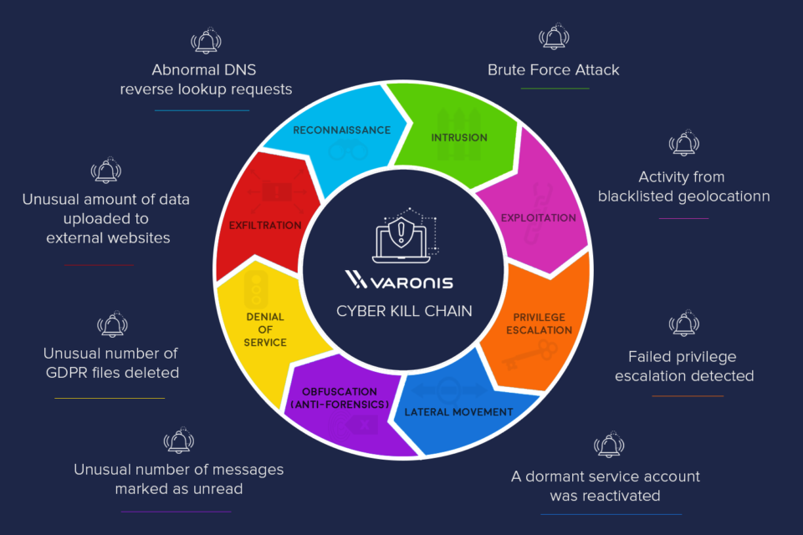
INTRODUCTION TO THE CYBER KILL CHAIN

Slide 16
INTRODUCTION TO SECURITY CONTROLS
Security controls are safeguards or countermeasures to avoid, detect, counteract, or minimize security risks to physical property, information, computer systems, or other assets. In the field of information security, such controls protect the confidentiality, integrity and availability of information.
Systems of controls can be referred to as frameworks or standards. Frameworks can enable an organization to manage security controls across different types of assets with consistency.
Wikipedia

Slide 17
INTRODUCTION TO SECURITY CONTROLS
Types of security controls
Security controls can be classified by several criteria. For example, according to the time that they act, relative to a security incident:
Before the event, preventive controls are intended to prevent an incident from occurring e.g. by locking out unauthorized intruders;
During the event, detective controls are intended to identify and characterize an incident in progress e.g. by sounding the intruder alarm and alerting the security guards or police;
After the event, corrective controls are intended to limit the extent of any damage caused by the incident e.g. by recovering the organization to normal working status as efficiently as possible.

Slide 18
INTRODUCTION TO SECURITY CONTROLS
Types of security controls
They can also be classified according to their nature, for example:
Physical controls e.g. fences, doors, locks and fire extinguishers;
Procedural controls e.g. incident response processes, management oversight, security awareness and training;
Technical controls e.g. user authentication (login) and logical access controls, antivirus software, firewalls;
Legal and regulatory or compliance controls e.g. privacy laws, policies and clauses.

Slide 19
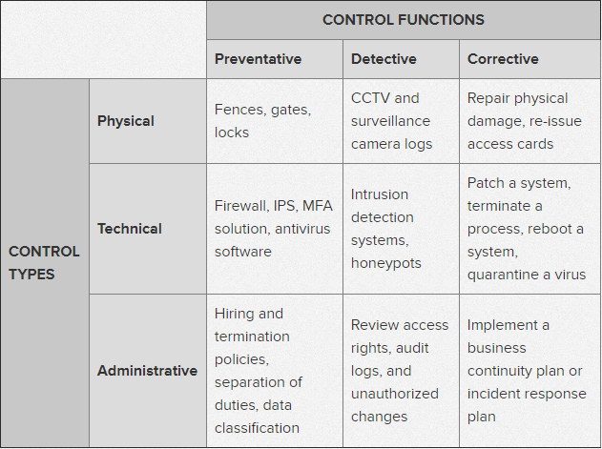
INTRODUCTION TO SECURITY CONTROLS
SECURITY CONTROL

Slide 20
Introduction to Security Laws and Standards
Numerous information security standards promote good security practices and define frameworks or systems to structure the analysis and design for managing information security controls. Some of the most well known are outlined below.
International Standards Organization
ISO/IEC 27001 specifies 114 controls in 14 groups:
A.5: Information security policies
A.6: How information security is organised
A.7: Human resources security - controls that are applied before, during, or after employment.
A.8: Asset management
A.9: Access controls and managing user access
A.10: Cryptographic technology

Slide 21
INTRODUCTION TO SECURITY LAWS AND STANDARDS
A.11: Physical security of the organisation's sites and equipment
A.12: Operational security
A.13: Secure communications and data transfer
A.14: Secure acquisition, development, and support of information systems
A.15: Security for suppliers and third parties
A.16: Incident management
A.17: Business continuity/disaster recovery (to the extent that it affects information security)
A.18: Compliance - with internal requirements, such as policies, and with external requirements, such as laws.

Slide 22
INTRODUCTION TO SECURITY LAWS AND STANDARDS
ISO/IEC 27001 requires that management:
Systematically examine the organization's information security risks, taking account of the threats, vulnerabilities, and impacts;
Design and implement a coherent and comprehensive suite of information security controls and/or other forms of risk treatment (such as risk avoidance or risk transfer) to address those risks that are deemed unacceptable; and
Adopt an overarching management process to ensure that the information security controls continue to meet the organization's information security needs on an ongoing basis.

Slide 23
INTRODUCTION TO SECURITY LAWS AND STANDARDS
The Nigerian Cybercrime Act 2015
The Cybercrimes Act 2015 is the first legislation in Nigeria that deals specifically with cyber security. Passed in May 2015, it gives effect to the 2011 ECOWAS Directive on fighting cyber crime and is broad in it scope.

Slide 24
INTRODUCTION TO SECURITY LAWS AND STANDARDS
Nigeria’s Cybercrime Act 2015 Key issues
Any person convicted of child pornography convictions will be receive 10 years in prison and/ or a N20 million fine, depending on the nature of the offence. Child pornography includes producing, procuring, distributing, and possession such images.
Anyone convicted of identity theft will receive result in 3 years’ imprisonment and/ or a N7 million fine.

Slide 25
INTRODUCTION TO SECURITY LAWS AND STANDARDS
Nigeria’s Cybercrime Act 2015 Key issues
The Act also outlaws cyber-stalking and cyber-bullying. Anyone convicted of these could receive a N2 million minimum fine and/or at least 1 year in prison. More severe offences could attract a penalty as high as a N25 million minimum fine and/or up to 10 years’ imprisonment, depending on the severity of the offence.

Slide 26
INTRODUCTION TO SECURITY LAWS AND STANDARDS
Nigeria’s Cybercrime Act 2015 Key issues
If hackers are found guilty of unlawfully accessing a computer system or network, they could be fined up to N10 million, imprisoned for 5 years, or both, depending on the purpose of the hack. The same applies to Internet fraudsters who commit cybercrimes by sending electronic messages, or accessing and using data on computer systems.

Slide 27
INTRODUCTION TO SECURITY LAWS AND STANDARDS
Nigeria’s Cybercrime Act 2015 Key issues
The president may decide that certain systems, networks and information infrastructure are vital to Nigeria’s national security or its citizens’ economic and social well-being. Therefore, the president may term them Critical National Information Infrastructure, and may implement procedures and guidelines for their use, and may conduct audits to make sure they are functioning as they’re supposed to. For example, the transportation, communications, banking sectors are critical national infrastructure.

Slide 28
INTRODUCTION TO SECURITY LAWS AND STANDARDS
Nigeria’s Cybercrime Act 2015 Key issues
A conviction for any offence committed against any part of Nigeria’s critical national infrastructure that results in someone’s death attracts the death penalty (and there are other punishments for lesser crimes).
The Act prohibits cybersquatting and anyone convicted of this faces at least 2 years’ imprisonment, and/or a minimum N5 million fine.

Slide 29
INTRODUCTION TO SECURITY LAWS AND STANDARDS
Nigeria’s Cybercrime Act 2015 Key issues
The distribution of racially or ethnically prejudicial or violent material through a computer system or network is prohibited. Convictions attract at least 5 year’s imprisonment and/or a minimum N10million fine.
Internet service providers (ISPs) are required to keep records of users’ Internet traffic and their subscriber data, and must safeguard this information so that the users’ constitutional right to privacy is respected.

Slide 30
INTRODUCTION TO SECURITY LAWS AND STANDARDS
the Act allows electronic communication to be intercepted, but only with a court order based on reasonable grounds to suspect that the information is required for a criminal investigation or proceedings.

Slide 31
INTRODUCTION TO SECURITY LAWS AND STANDARDS
A definition of PCI compliance
The Payment Card Industry Data Security Standard (PCI DSS) is a set of requirements intended to ensure that all companies that process, store, or transmit credit card information maintain a secure environment. It was launched on September 7, 2006, to manage PCI security standards and improve account security throughout the transaction process. An independent body created by Visa, MasterCard, American Express, Discover, and JCB, the PCI Security Standards Council (PCI SSC) administers and manages the PCI DSS. Interestingly, the payment brands and acquirers are responsible for enforcing compliance, rather than the PCI SSC.

Slide 32
INTRODUCTION TO SECURITY LAWS AND STANDARDS
The 12 requirements for PCI DSS compliance
Use Firewall
Proper password protection
Protect cardholder data
Encrypt transmitted data
Use and maintain antivirus
Use properly updated softwares
Restrict data access
Unique IDS for access
Restrict physical access
Create and maintain access log
Scan and test for vulnerability
Document policies

Slide 33
MODULE 2
FOOTPRINTING AND RECONNAISSANCE

Slide 34
WHOIS FOOTPRINTING
Footprinting (also known as reconnaissance) is the technique used for gathering information about computer systems and the entities they belong to. To get this information, a hacker might use various tools and technologies. This information is very useful to a hacker who is trying to crack a whole system.
Objectives of Footprinting
Network Footprinting
This is the process of collecting information related to a target network. Information like Domain name, subdomains, network blocks, IP addresses of reachable systems, IDSes running, Rouge websites/private websites, TCP & UDP services running, VPN points, networking protocols, ACL's, etc are collected.
Collect System Information
The information related to the target system like user and group names, system banners, routing tables, SNMP information, system names etc are collected using various methods.

Slide 35
WHOIS FOOTPRINTING
Collect Organization's information –
The information related to employee details, organization website, Location details, security policies implemented, the background of the organization may serve as an important piece of information for compromising the security of the target using direct or social engineering attacks.
Whois footprinting
WHOIS (pronounced as the phrase who is) is a query and response protocol and whois footprinting is a method for glance information about ownership of a domain name as following:
Domain name details
Contact details contain phone no. and email address of the owner
Registration date for the domain name
Expire date for the domain name
Domain name servers

Slide 36
WHOIS FOOTPRINTING
Whois Lookup
It is broadly used in support of querying databases that store the registered users or assignees of an Internet resource, such as a domain name, an IP address block, or an autonomous system, but is also used for a wider range of other information. The protocol stores and delivers database content in a human-readable format.

Slide 37
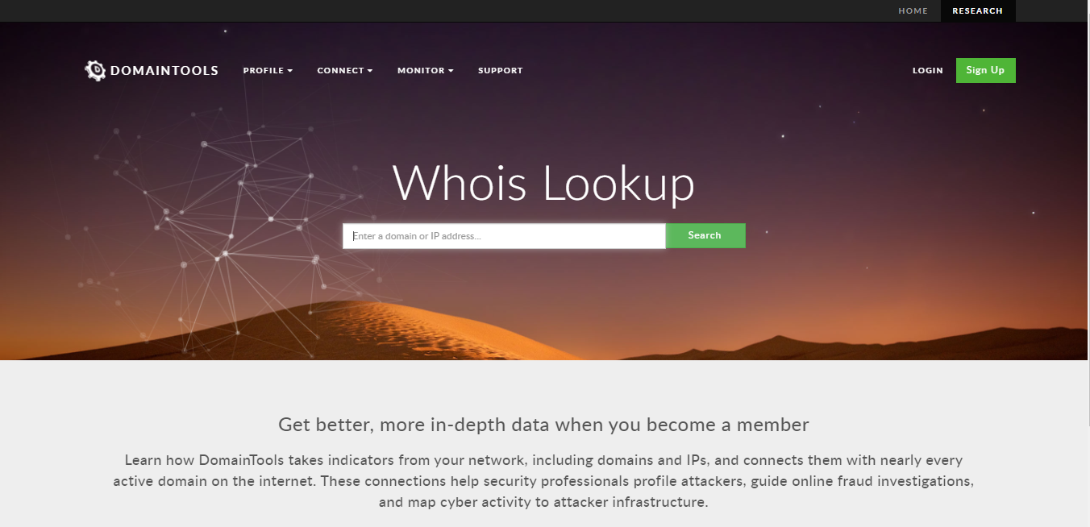
WHOIS FOOTPRINTING
www.whois.domaintools.com

Slide 38
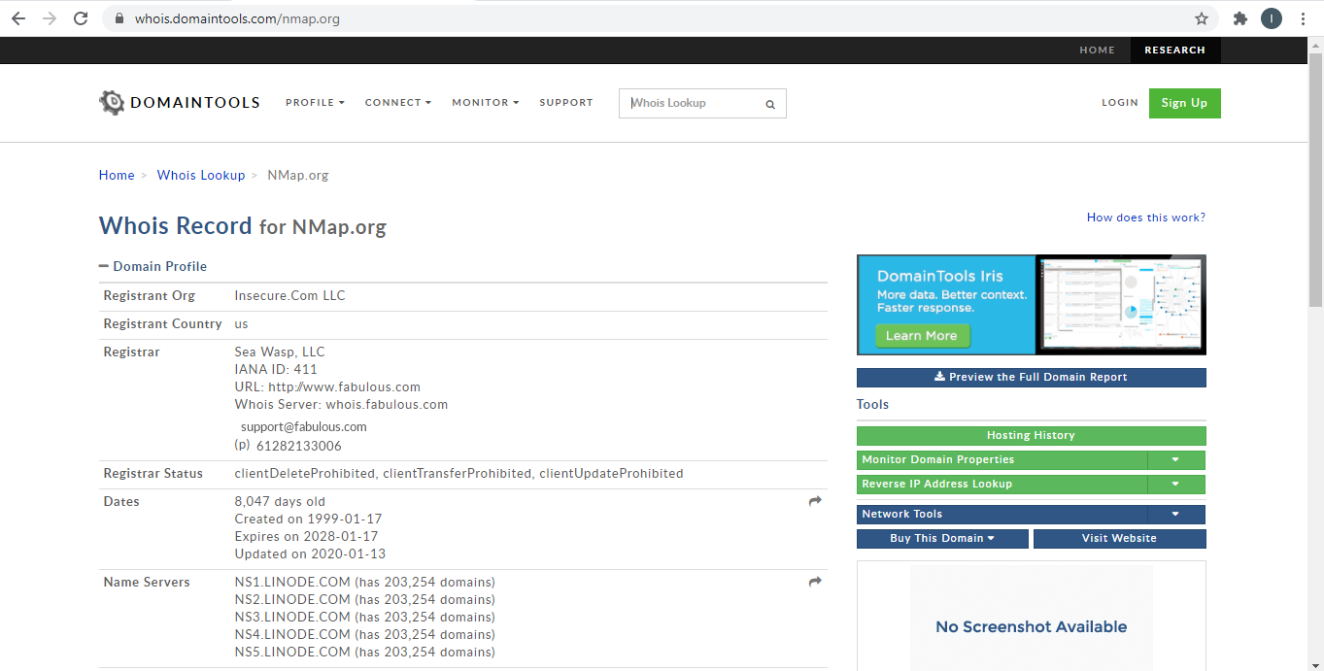
WHOIS FOOTPRINTING

Slide 39
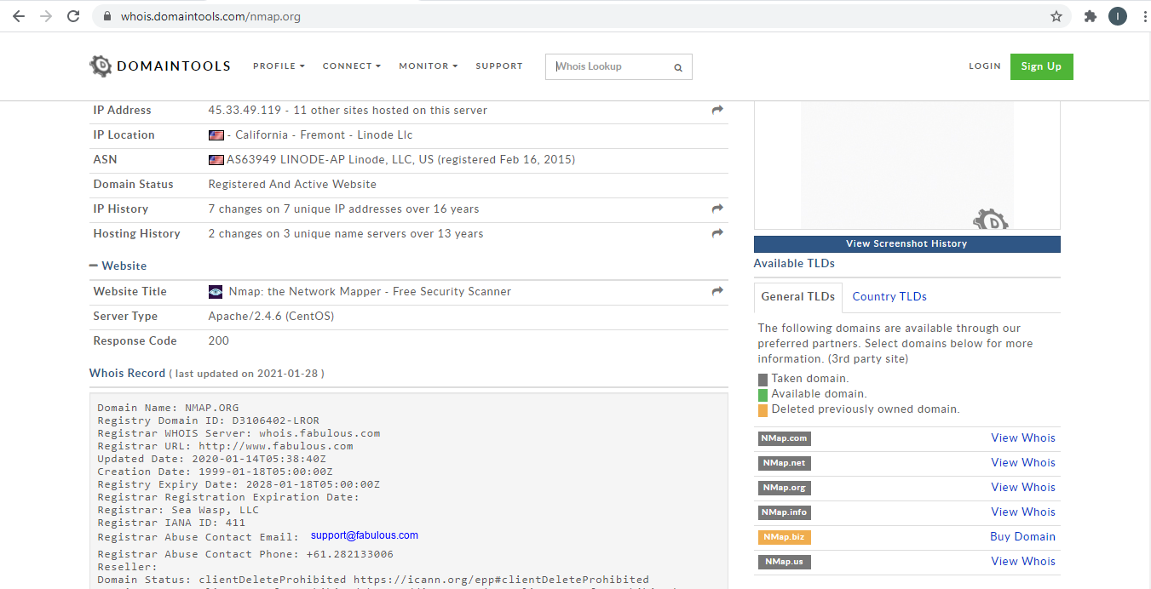
WHOIS FOOTPRINTING

Slide 40
FOOTPRINTING THROUGH SEARCH ENGINE
Footprinting through Search Engines
Attackers use search engines to extract information about a target such as technology platforms, employee details, login pages, intranet portals, etc. which helps in performing social engineering and other types of advanced system attacks.
Search engine caches and internet archives may also provide sensitive information that has been removed from the World Wide Web (WWW).

Slide 41
FOOTPRINTING THROUGH SEARCH ENGINE
There are many search engines where you can find anything that desires from finding the meaning of the word to finding a person. Such search engines are:
www.google.com
www.bing.com
www.shodan.io
www.duckduckgo.com

Slide 42
FOOTPRINTING THROUGH SEARCH ENGINE
There are many search engines where you can find anything that desires from finding the meaning of the word to finding a person. Such search engines are:
www.google.com
www.bing.com
www.shodan.io
www.duckduckgo.com

Slide 43
SOCIAL MEDIA FOOTPRINTING
Collect Information through Social Engineering on Social Networking Sites
Attackers use social engineering trick to gather sensitive information from social networking websites such as Facebook, MySpace, LinkedIn, Twitter, Pinterest, Google+, etc.
Attackers create a fake profile on social networking sites and then use the false identity to lure the employees to give up their sensitive information.

Slide 44
SOCIAL MEDIA FOOTPRINTING
Employees may post personal information such as date of birth, educational and employment backgrounds, spouses names, etc. and information about their company such as potential clients and business partners, trade secrets of business, websites, company's upcoming news, mergers, acquisitions, etc.
Attackers collect information about employee's interests by tracking their groups and then trick the employee to reveal more information.

Slide 45
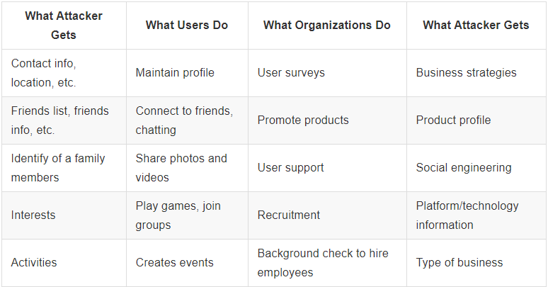
SOCIAL MEDIA FOOTPRINTING
Information Available on Social Networking site

Slide 46
MODULE 3
SOCIAL ENGINEERING

Slide 47
SOCIAL ENGINEERING
What is social engineering
Social engineering is an attempt by attackers to fool or manipulate humans into giving up access, credentials, banking details, or other sensitive information.
The types of information these criminals are seeking can vary, but when individuals are targeted the criminals are usually trying to trick you into giving them your passwords or bank information, or access your computer to secretly install malicious software–that will give them access to your passwords and bank information as well as giving them control over your computer.

Slide 48
SOCIAL ENGINEERING
Social engineering occurs in three stages:
Research - the attacker performs reconnaissance on the target to gather information like organizational structure, roles, behaviors, and things that target individuals may respond to. Attackers can collect data via company websites, social media profiles and even in-person visits.
Planning - busing the information they gathered, the attacker selects their mode of attack and designs the strategy and specific messages they will use to exploit the target individuals’ weaknesses.
Execution - the attacker carries out the attack usually by sending messages by email or another online channel. In some forms of social engineering, attackers actively interact with their victims; in others, the kill chain is automated, typically activated by the user clicking on a link to visit a malicious website or execute malicious code.

Slide 49
SOCIAL ENGINEERING
Social engineering techniques
According to the InfoSec Institute, the following five techniques are among the most commonly used social engineering attacks.
Phishing In a phishing attack, an attacker uses a message sent by email, social media, instant messaging clients or SMS to obtain sensitive information from a victim or trick them into clicking a link to a malicious website.

Slide 50
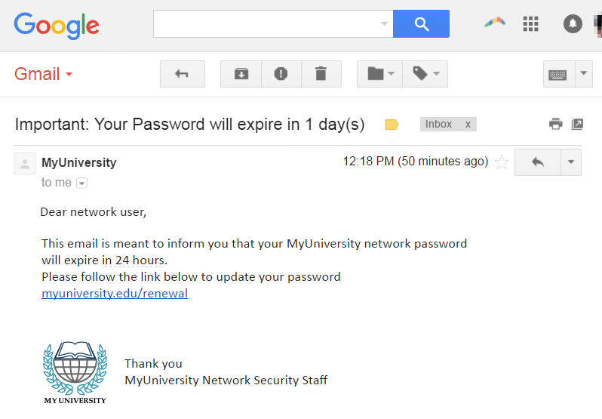
SOCIAL ENGINEERING
Phishing Mail

Slide 51
SOCIAL ENGINEERING
Several things can occur by clicking the link. For example:
The user is redirected to myuniversity.edurenewal.com, a bogus page appearing exactly like the real renewal page, where both new and existing passwords are requested. The attacker, monitoring the page, hijacks the original password to gain access to secured areas on the university network.
The user is sent to the actual password renewal page. However, while being redirected, a malicious script activates in the background to hijack the user’s session cookie. This results in a reflected XSS attack, giving the perpetrator privileged access to the university network.

Slide 52
SOCIAL ENGINEERING
2. Watering hole
A watering hole attack involves launching or downloading malicious code from a legitimate website, which is commonly visited by the targets of the attack. For example, attackers might compromise a financial industry news site, knowing that individuals who work in finance and thus represent an attractive target, are likely to visit this site. The compromised site typically installs a backdoor trojan that allows the attacker to compromise and remotely control the victim’s device.

Slide 53
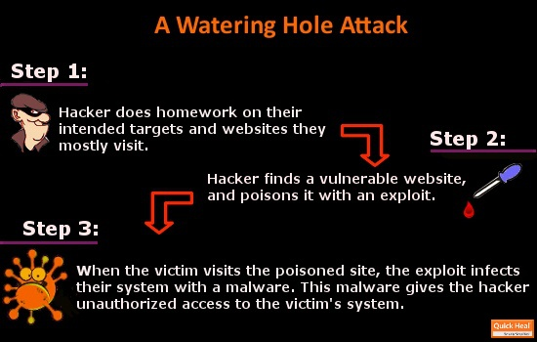
SOCIAL ENGINEERING
Watering Hole Attack

Slide 54
SOCIAL ENGINEERING
3. Whaling attack
Whaling, also known as spear phishing, is a type of phishing attack that targets specific individuals with privileged access to systems or access to highly valuable sensitive information. For example, a whaling attack may be conducted against senior executives, wealthy individuals, or network administrators.
Whaling emails often pretend to be a critical business email sent by a colleague, employee or manager of the target, requiring urgent intervention from the victim.

Slide 55
SOCIAL ENGINEERING
The difference between whaling and spear phishing is that whaling exclusively targets high-ranking individuals within an organization, while spear phishing usually goes after a category of individuals with a lower profile.

Slide 56
SOCIAL ENGINEERING
4. Pretexting
In a pretexting attack, attackers create a fake identity and use it to manipulate their victims into providing private information. For example, attackers may pretend to be an external IT service provider, and request user’s account details and passwords to assist them with a problem. Or they might pretend to be the victim’s financial institution, asking them for confirmation of their bank account number or bank website credentials.

Slide 57
SOCIAL ENGINEERING
5. Baiting and quid pro quo attacks
In a baiting attack, attackers provide something that victims believe to be useful. This may be a supposed software update which in fact is a malicious file, an infected USB token with a label indicating it contains valuable information and other methods.

Slide 58

SOCIAL ENGINEERING
5. Baiting and quid pro quo attacks
Baiting Attack

Slide 59
SOCIAL ENGINEERING
How to Recognize a Social Engineering
Asking for immediate assistance
Asking you to donate to a charitable cause
Asking you to "verify" your information
Responding to a question you didn't ask

Slide 60
SOCIAL ENGINEERING
How to Prevent Social Engineering (Coutermeasures)?
Identify your valuables
Verify Identities
Slow down
Verify links before clicking
Education
Email protection software

Slide 61
MODULE 4
IDENTITY AND ACCESS MANAGEMENT

Slide 62
IDENTITY AND ACCESS MANAGEMENT
Identity and access management
Identity and access management (IAM) in enterprise IT is about defining and managing the roles and access privileges of individual network users and the circumstances in which users are granted (or denied) those privileges. Those users might be customers (customer identity management) or employees (employee identity management.

Slide 63
IDENTITY AND ACCESS MANAGEMENT
How identity and access management works
IAM systems are designed to perform three key tasks: identify, authenticate, and authorize. Meaning, only the right persons should have access to computers, hardware, software apps, any IT resources, or perform specific tasks.
Some core IAM components making up an IAM framework include:
A database containing users’ identities and access privileges
IAM tools for creating, monitoring, modifying, and deleting access privileges
A system for auditing login and access history

Slide 64
IDENTITY AND ACCESS MANAGEMENT
Examples of identity and access management
When a user enters his login credentials, his identity would be checked against a database to verify if the entered credentials match the ones stored in the database. For example, when a contributor logs into a content management system, he’s allowed to post his work. However, he’s not allowed to make changes to other users’ works.

Slide 65
IDENTITY AND ACCESS MANAGEMENT
Examples of identity and access management
A production operator can view an online work procedure but may not be allowed to modify it. On the other hand, a supervisor may have the power not only to view but also to modify the file or create a new one. If there’s no IAM in place, anyone can modify the document, and this could lead to disastrous effects.

Slide 66
IDENTITY AND ACCESS MANAGEMENT
Examples of identity and access management
Through IAM, only specific users in the organization are allowed to access and handle sensitive information. If there’s no IAM, anyone (like outsiders) could access confidential company files, leading to a possible data breach. In this aspect, IAM helps companies meet stringent and complex regulations that govern data management.

Slide 67
IDENTITY AND ACCESS MANAGEMENT
Identity And Access Management Implementation
ROLE-BASED ACCESS
Many IAM systems use role-based access control (RBAC). Under this approach, there are predefined job roles with specific sets of access privileges. Take HR employees as an RBAC example. If one HR officer is in charge of training, it makes little sense if that officer is given access to payroll and salary files.
SINGLE SIGN-ON
Some IAM systems implement Single Sign-On (SSO). With SSO, users only need to verify themselves one time. They would then be given access to all systems without the need to log separately into each system.

Slide 68
IDENTITY AND ACCESS MANAGEMENT
Identity And Access Management Implementation
MULTI-FACTOR AUTHENTICATION
Whenever extra steps are required for authentication, it’s either a two-factor authentication (2FA) or multi-factor authentication (MFA). This authentication process combines something the user knows (like a password) with something the user has (like a security token or OTP) or something that’s part of the user’s body (like biometrics).

Slide 69
IDENTITY AND ACCESS MANAGEMENT
Identity And Access Management Implementation
MULTI-FACTOR AUTHENTICATION
Whenever extra steps are required for authentication, it’s either a two-factor authentication (2FA) or multi-factor authentication (MFA). This authentication process combines something the user knows (like a password) with something the user has (like a security token or OTP) or something that’s part of the user’s body (like biometrics).

Slide 70
IDENTITY AND ACCESS MANAGEMENT
Access Control Methodologies and Implementation
There are two primary access control methodologies: centralized and decentralized (or distributed).
Centralized access control implies that all authorization verification is performed by a single entity within a system.
Decentralized access control, or distributed access control, implies that authorization verification is performed by various entities located throughout a system.

Slide 71
IDENTITY AND ACCESS MANAGEMENT
Centralized and Decentralized Access Control
Centralized and decentralized access control methodologies offer the benefits and drawbacks that any centralized or decentralized system offers. Centralized access control can be managed by a small team or an individual. Administrative overhead is lower because ...

Slide 72
IDENTITY AND ACCESS MANAGEMENT
Types of Access Control
Access control types include the following three that we'll look at one at a time.
Administrative Access Control
Administrative access control sets the access control policies and procedures for the whole organization, defines the implementation requirements of both physical and technical access control, and what the consequences of non-compliance will be. Some examples include supervisory structure, staff and contractor controls, information classification, training, auditing, and testing.

Slide 73
IDENTITY AND ACCESS MANAGEMENT
Types of Access Control
Physical Access Control
Physical access control is critical to an organization's security and applies to the access or restriction of access to a place such as property, building, or room. Some examples are fences, gates, doors, turnstiles, etc., using locks, badges, biometrics (facial recognition, fingerprints), video surveillance cameras, security guards, motion detectors, man-trap doors, etc. to allow access to certain areas.

Slide 74
IDENTITY AND ACCESS MANAGEMENT
Types of Access Control
Technical or Logical Access Control
Technical or logical access control limits connections to computer networks, system files, and data. It enforces restrictions on applications, protocols, operating systems, encryptions, mechanisms, etc.
In today's increasingly digital world, modern access control systems combine both administrative, physical, and technical access control to limit access to sensitive data and physical locations, providing a much higher level of security. Some examples are access control lists, intrusion detection systems, and antivirus software.

Slide 75
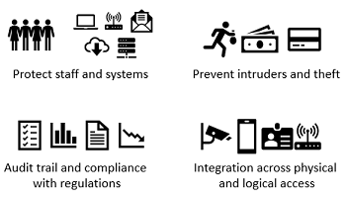
IDENTITY AND ACCESS MANAGEMENT
Advantages of Access Control

Slide 76
MODULE 5
INTRODUCTION TO SYTEM HACKING

Slide 77
INTRODUCTION TO SYSTEM HACKING
What is Hacking?
Hacking is the activity of identifying weaknesses in a computer system or a network to exploit the security to gain access to personal data or business data. An example of computer hacking can be: using a password cracking algorithm to gain access to a computer system.
Who is a Hacker?
A Hacker is a person who finds and exploits the weakness in computer systems and/or networks to gain access. Hackers are usually skilled computer programmers with knowledge of computer security.

Slide 78
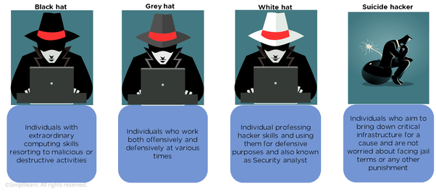
INTRODUCTION TO SYSTEM HACKING
TYPES OF HACKERS

Slide 79
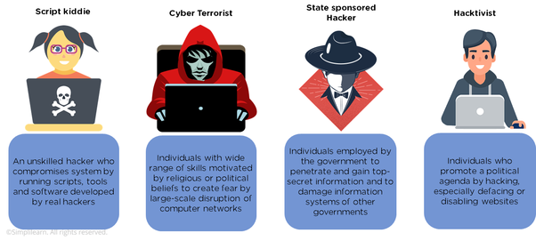
INTRODUCTION TO SYSTEM HACKING
TYPES OF HACKERS

Slide 80
INTRODUCTION TO SYSTEM HACKING
Hacking methodology
Although there is no specific step-by-step methodology used by all hackers, a typical hacking process comprises of the following steps:
1. Footprinting – the process of using passive methods of gaining information about the target system prior to performing the attack. The interaction with the target system is kept at minimum in order to avoid detection and alert the target about the attack. The footprinting can reveal vulnerabilities of the target system and improve the ease with which they can be exploited. Various methods are employed for footprinting, for example whois queries, Google searches, job boards search, network enumeration, operating system identification, etc.

Slide 81
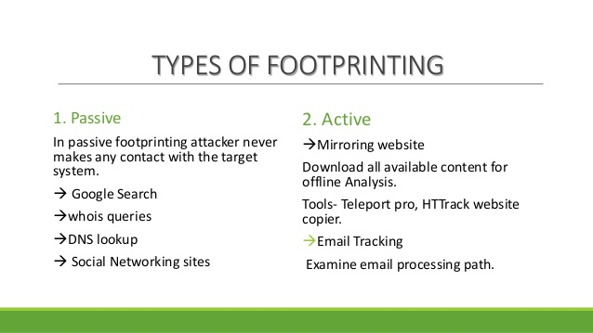
INTRODUCTION TO SYSTEM HACKING

Slide 82
INTRODUCTION TO SYSTEM HACKING
Hacking methodology
2. Scanning – the process of taking information obtained from the footprinting phase in order to target the attack more precisely. Some of the metods used in this phase are port scans, ping sweeps, operating systems detection, observation of facilities used by the target, and so on.

Slide 83
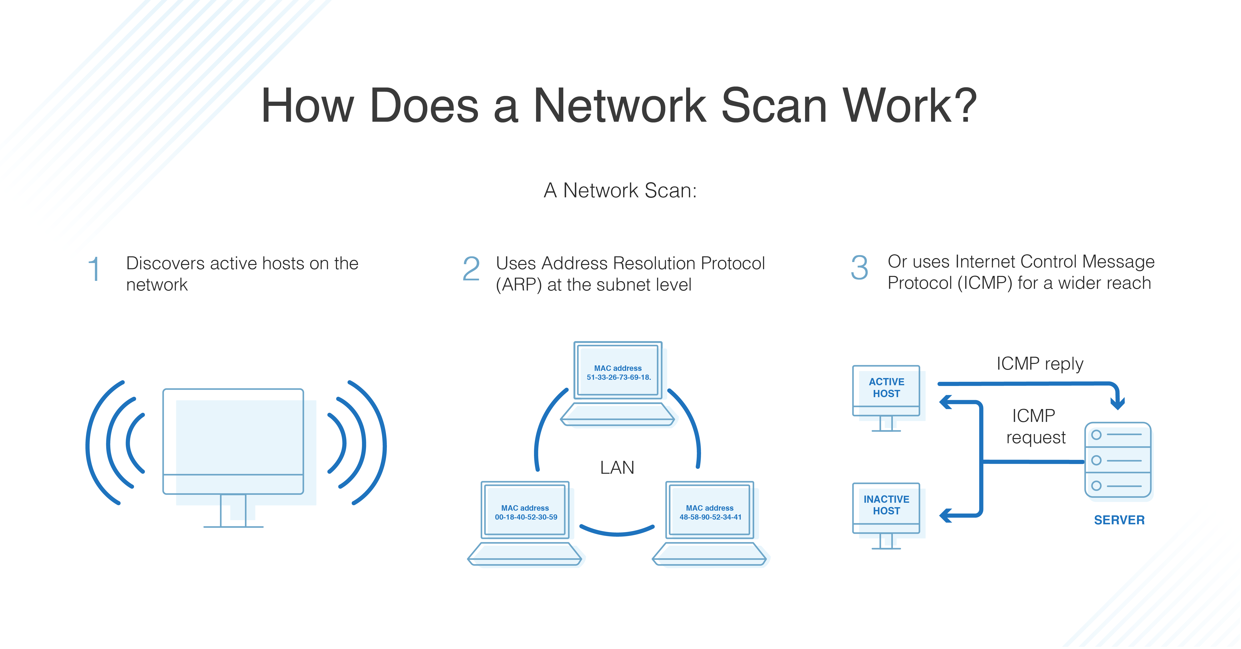
INTRODUCTION TO SYSTEM HACKING

Slide 84
INTRODUCTION TO SYSTEM HACKING
3. Enumeration – the process of extracting more detailed information about the information obtained during the scanning phase to determine its usefulness. Some of the methods used in this step are user accounts enumeration, SNMP enumeration, UNIX/Linux enumeration, LDAP enumeration, NTP enumeration, SMTP enumeration, DNS enumeration, etc.

Slide 85
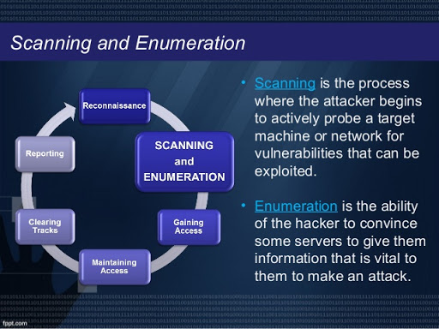
INTRODUCTION TO SYSTEM HACKING

Slide 86
INTRODUCTION TO SYSTEM HACKING
Hacking methodology
4. System hacking – the process of planning and executing the attack based on the information obtained in the previous phases. In this phase the attacker performs the actual hacking process using hacking tools.
5. Escalation of privilege – the process of obtaining privileges that are granted to higher privileged accounts than the attacker broke into originally. The goal of this step is to move from a low-level account (such as a guest account) all the way up to administrator.

Slide 87
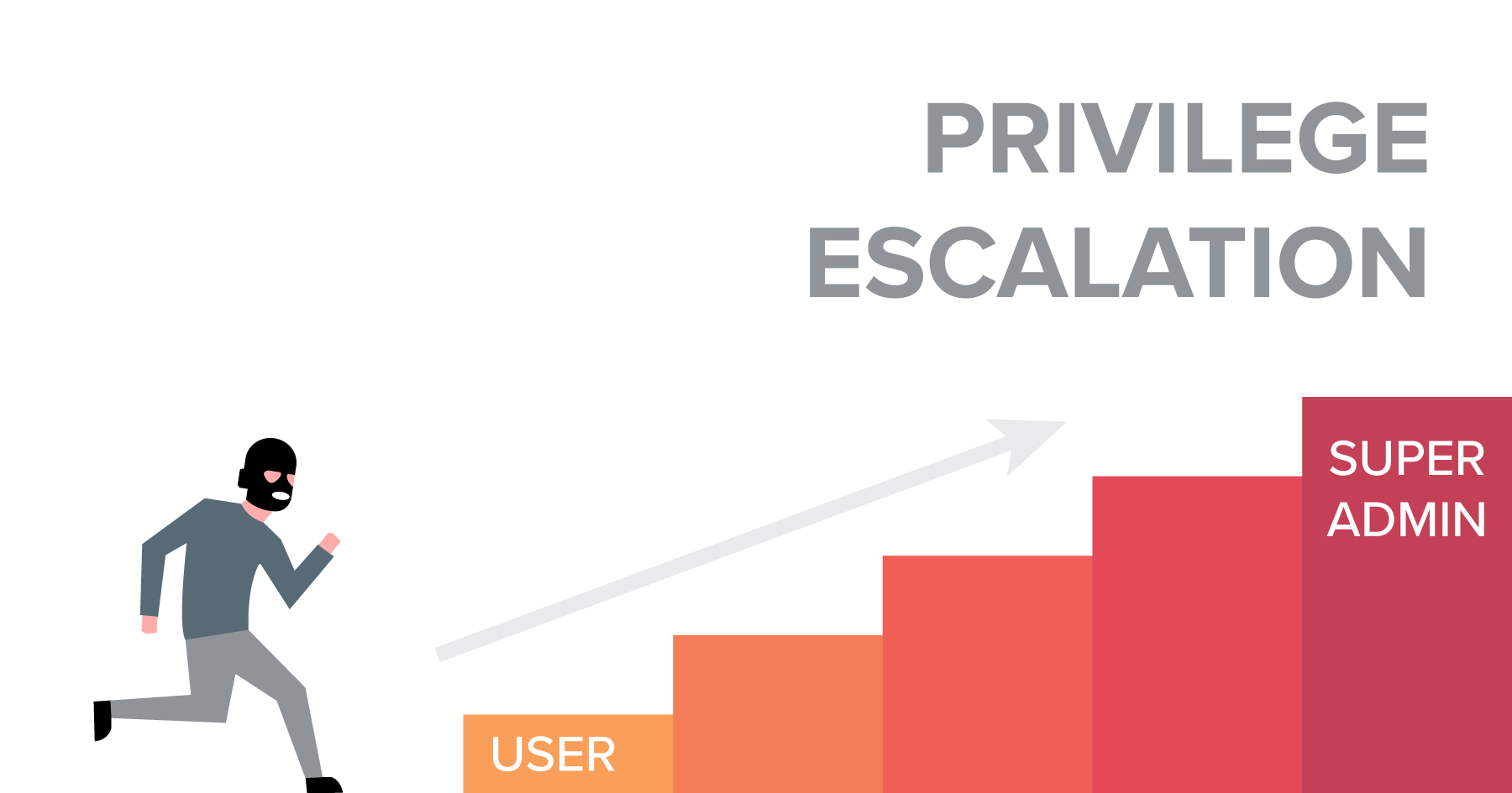
INTRODUCTION TO SYSTEM HACKING

Slide 88

INTRODUCTION TO SYSTEM HACKING
COVERING TRACKS

Slide 89
INTRODUCTION TO SYSTEM HACKING
6. Covering tracks – the process of removing any evidence of the attacker’s presence in a system. The attacker purges log files and removes other evidence needed for the owner of the system to determine that an attack occured.

Slide 90
INTRODUCTION TO SYSTEM HACKING
7. Planting backdoors – the process of securing unauthorized remote access to a computer, so the attacker can access the system later without being detected. Backdoors are usually computer programs that give an attacker the remote access to a targeted computer system.

Slide 91
COUNTERMEASURES FOR ENSURING PROTECTION OF DIGITAL ASSETS AT WORKPLACE
Stay Up-to-Date
Malicious hackers are always on the lookout for security loopholes that they can use as attack vectors in either gaining access to your system or distributing their malicious code and apps. One such attack vector involves zero-day exploits or unpatched vulnerabilities. Software developers try to keep up by releasing regular patches and updates that will solve these multiple issues (along with new feature releases, of course).

Slide 92
COUNTERMEASURES FOR ENSURING PROTECTION OF DIGITAL ASSETS AT WORKPLACE
Deploy Active Protection for Your Assets
Web and application servers are a popular target for malicious hackers because these are always online, and always accept traffic and requests sent from the internet at large. Thus, there is also the risk that hackers can find security vulnerabilities on your server itself, or the applications that reside in it.

Slide 93
COUNTERMEASURES FOR ENSURING PROTECTION OF DIGITAL ASSETS AT WORKPLACE
Secure Your Local Infrastructure
With all the data and digital information that resides on either the cloud or your local servers, it is sometimes easy to overlook the physical aspect of security. This means potential attackers can easily access your company’s data and information through physical or similar means.

Slide 94
COUNTERMEASURES FOR ENSURING PROTECTION OF DIGITAL ASSETS AT WORKPLACE
Educate Your Organization
Another oft-overlooked aspect of security is the human aspect. Again, the chain is only as secure as the weakest link. And if your employees are not aware of their responsibilities as users and members of your organization, then they might easily fall victim to attacks like scams, phishing, ransomware incursions, and the like.

Slide 95
COUNTERMEASURES FOR ENSURING PROTECTION OF DIGITAL ASSETS AT WORKPLACE
Use Secure Authentication
Another aspect of education, of course, is the use of strong passwords. There are different schools of thought with regard to using passwords. Some security experts say that forcing everyone to change passwords too frequently might mean they will have a hard time memorizing their passwords and will write their passwords somewhere, which defeats the purpose.

Slide 96
COUNTERMEASURES FOR ENSURING PROTECTION OF DIGITAL ASSETS AT WORKPLACE
Stay Abreast of Security Trends
Security is an ever-evolving field. Every day, there are new vulnerabilities being discovered and exploited. There are also new methodologies being carried out by attackers, especially in doing social engineering attacks. The responsibility of keeping up-to-date and using the best tools and measures to improve the company’s security

